Slide 1
Evaluation of Go Concurrency
Yifu Luo
Lei Xu

Slide 2
Road Map
Goroutine memory usage
Difference between go concurrency and parallel
Benchmark on difference ways to handle race condition

Slide 3
Basic Setup
All experimentations are performed on
MacBook Pro, 2.2 GHz Intel Core i7, 16GB DDR3.
macOS: 10.13.4
Go version: 1.10

Slide 4
Goroutine
Goroutines can be thought of as light weight threads.
The cost of creating a Goroutine is tiny when compared to a thread.
Hence its common for Go applications to have thousands of Goroutines running concurrently.
Notes:
Goroutines can be thought of as light weight threads.
The cost of creating a Goroutine is tiny when compared to a thread.
Hence its common for Go applications to have thousands of Goroutines running concurrently.

Slide 5

1.Memory Usage Benchmark
# Goroutine
Allocated Memory(MB)
runtime.MemStats.alloc()
Notes:
A goroutine is created with initial only 2KB of stack size.
You can run more goroutines on a typical system than you can threads.
Goroutines have growable segmented stacks.
Goroutines have a faster startup time than threads.
Goroutines come with built-in primitives to communicate safely between themselves (channels).
Goroutines allow you to avoid having to resort to mutex locking when sharing data structures.
Goroutines are multiplexed onto a small number of OS threads, rather than a 1:1 mapping.
You can write massively concurrent servers without having to resort to evented programming.
s

Slide 6
Concurrency and Parallel are different
Concurrency is about dealing with lots of things at once. Parallelism is about doing lots of things at once.
Concurrency is when two or more tasks can start, run, and complete in overlapping time periods. It doesn't necessarily mean they'll ever both be running at the same instant. For example, multitasking on a single-core machine.
Parallelism is when tasks literally run at the same time, e.g., on a multicore processor.
Notes:
Concurrency is about dealing with lots of things at once.
Parallelism is about doing lots of things at once.
Not the same, but related.
Concurrency is about structure, parallelism is about execution.
Concurrency provides a way to structure a solution to solve a problem that may (but not necessarily) be parallelizable.
Concurrent: Mouse, keyboard, display, and disk drivers.
Parallel: Vector dot product.

Slide 7
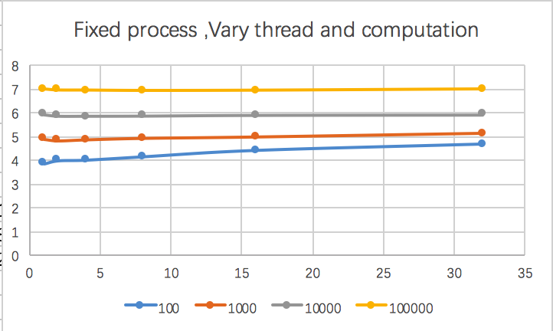
2.Benchmark on go concurrent computation(merge sort)
NS per operation in log format
For matrix size bigger than 100,
We can see a decrease
Of computation time and than
Increase.
There is overhead for using
More goroutine. Not just for
Allocation, but scheduling.
Notes:
We tested performance on Monte Carlo simulation, merge sort and matrix multiplication.We only show part of our result for simplicity of the plots.

Slide 8
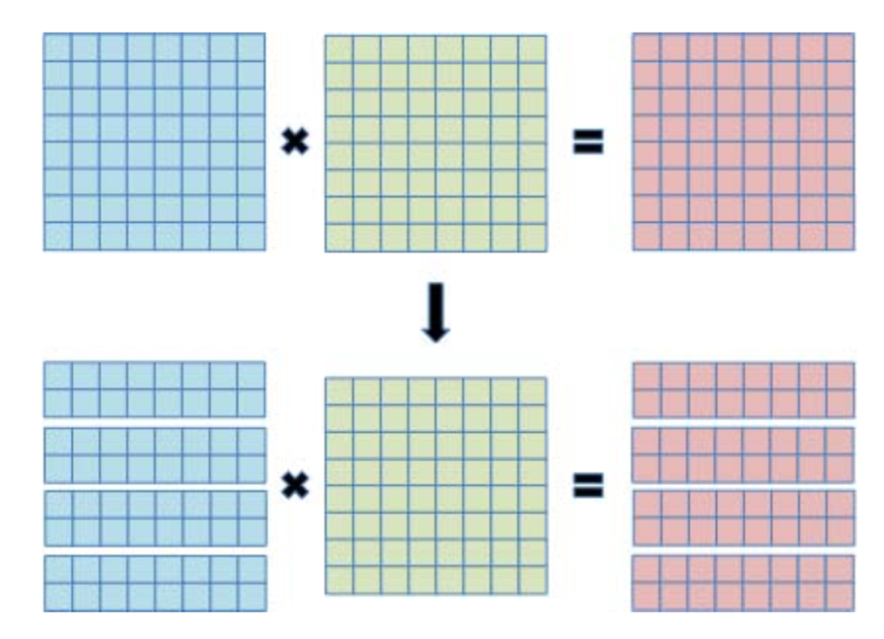
3. Benchmark on Matrix Multiplication
1500 X 1500
Control the number of Goroutine and the number of processor we use.
runtime.GOMAXPROCS(numCPUs)
Notes:
To analyze the performance, we prepare simple matrix multiplication programs
To simplify the problem, we define two matrices that have same length of row and column.
First, we divide matrix A into some processes, and calculate the product of a part of A and matrix B.
After completion of all calculation, we combine them

Slide 9
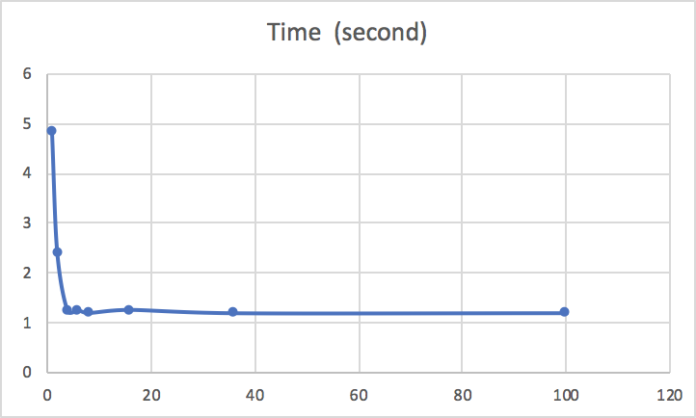

# Processors
# Goroutines
#Processor = 8
#Goroutine = 8
Notes:
Solving a problem concurrently seems that it will reduce the computational time immensely. However, everything comes at a price. Even though we think that doing many things at once will speed things up, there is a cost due to the communication between threads and to make sure that they won’t crash or make wrong outputs. Concurrent programming has to be done with great care and it causes an unavoidable overhead to program.
Time to initialize
Time finalize
Overhead due to external libraries
Cost to communicate between threads
Even if tens of thousands of goroutines have been spawned, it’s not a waste of system resources if most of them are blocked on one of these since the runtime schedules another goroutine instead.
In simple terms, goroutines are a lightweight abstraction over threads. A Go programmer does not deal with threads, and similarly the OS is not aware of the existence of goroutines.
Increasing the number of cores may not necessarily improve the performance of your program, depending on its design. The profiling tools can be used to find the ideal number of cores for your program.

Slide 10
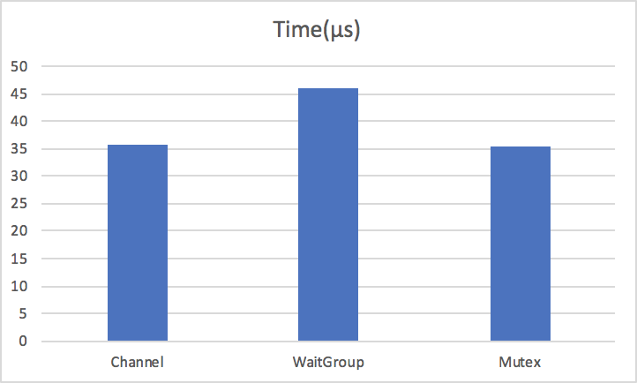
Handle Race Condition
go run -race example.go
WaitGroup
Channel
Mutex
Notes:
Two or more goroutines have access to the same resource, such as a variable or data structure and attempt to read and write to that resource without any regard to the other routines.
1.Blocking with waitgroups
The most straightforward way of solving a data race, is to block read access until the write operation has been completed:
Channel is a communication pipeline based on the Communicating Sequential Processes

Slide 11
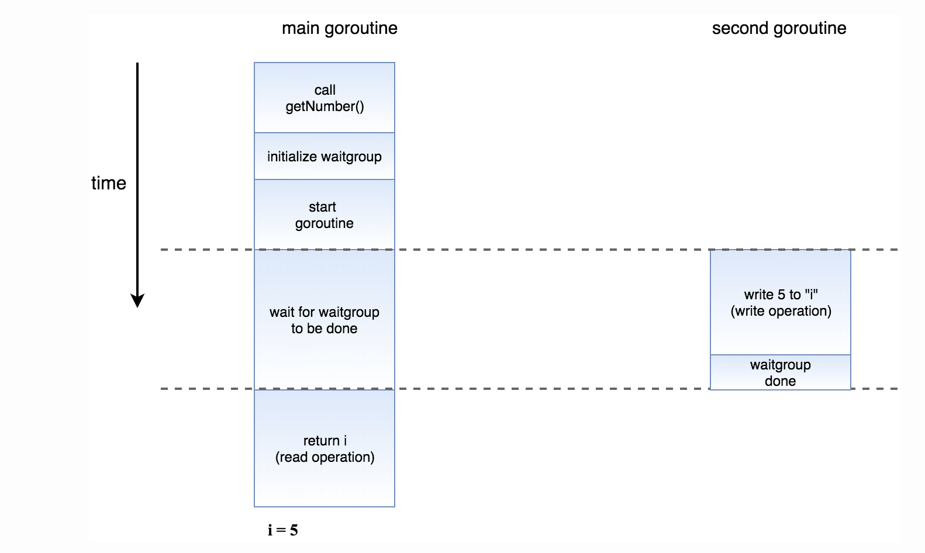
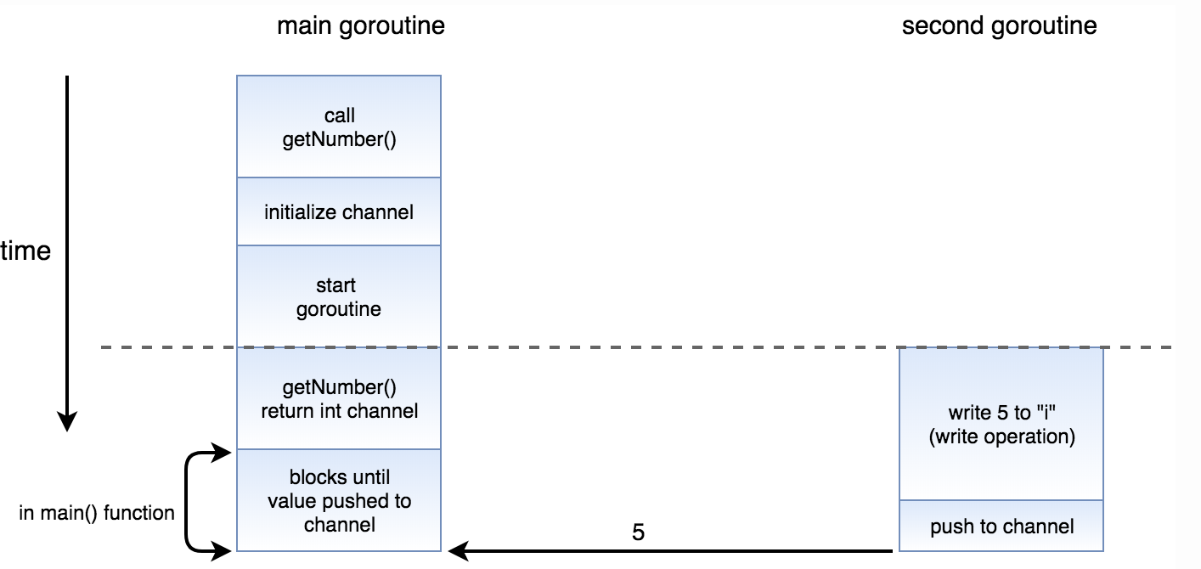
WaitGroup
Channel
var wg = sync.WaitGroup
wg.Add()
wg.Done()
wg.Wait()
value := make(chan int)
value <- 5
Notes:
Two or more goroutines have access to the same resource, such as a variable or data structure and attempt to read and write to that resource without any regard to the other routines.
1.Blocking with waitgroups
The most straightforward way of solving a data race, is to block read access until the write operation has been completed:Channel is a communication pipeline based on the Communicating Sequential Processes
// Initialize a waitgroup variable
var wg sync.WaitGroup
// `Add(1) signifies that there is 1 task that we need to wait for
// Calling `wg.Done` indicates that we are done with the task we are waiting fo
// `wg.Wait` blocks until `wg.Done` is called the same number of times
// as the amount of tasks we have (in this case, 1 time)
c := make(chan int)
go func() {
// push the result into the channel
c <- 5
}()
// immediately return the channel
return c

Slide 12
Conclusion
Difference between concurrency and parallel.
Just increase concurrency does not guarantee proportional speedup.
Go concurrency control is awesome.
Notes:
In programming, concurrency is the composition of independently executing processes, while parallelism is the simultaneous execution of (possibly related) computations
You can run more goroutines on a typical system than you can threads.
Goroutines have growable segmented stacks.
Goroutines have a faster startup time than threads.
Goroutines come with built-in primitives to communicate safely between themselves (channels).
Goroutines allow you to avoid having to resort to mutex locking when sharing data structures.
Goroutines are multiplexed onto a small number of OS threads, rather than a 1:1 mapping.
You can write massively concurrent servers withouth having to resort to evented programming.

Slide 13
Thanks

